Slide 1
The String Class

Slide 2
Constructing a String:
  String message = "Welcome to Java!”
  String is an Object in Java.

Slide 3
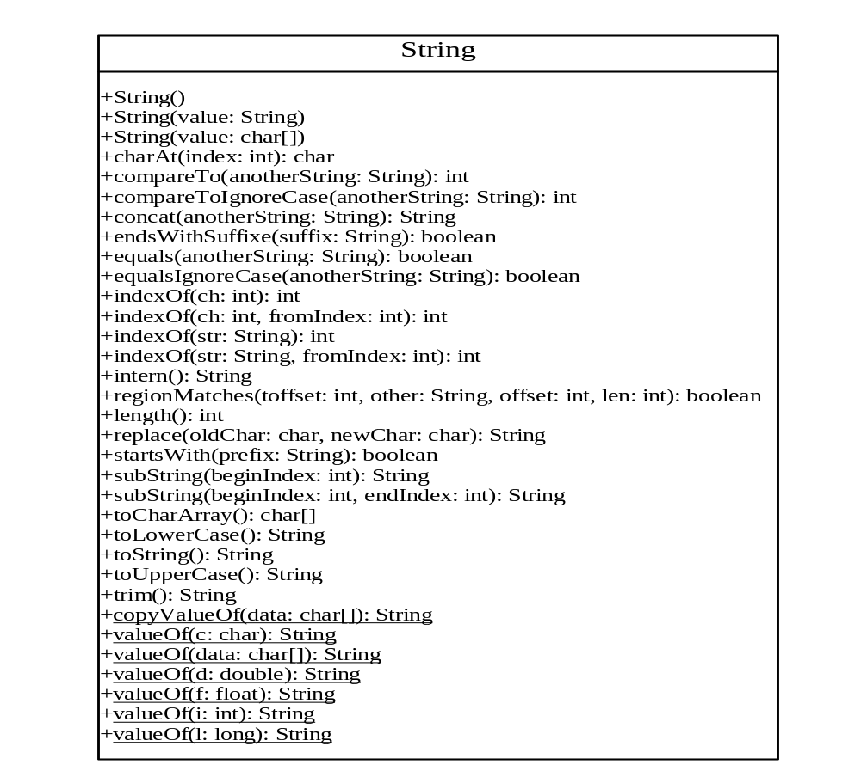

Slide 4
Constructing Strings
Strings newString = new String(stringLiteral);
String message = new String("Welcome to Java!");
Since strings are used frequently, Java provides a shorthand notation for creating a string:
String message = "Welcome to Java!";

Slide 5
Strings Are Immutable
A String object is immutable, whose contents cannot be changed.
To improve efficiency and save memory, Java Virtual Machine stores two String objects into the same object, if the two String objects are created with the same string literal using the shorthand notation. Therefore, the shorthand notation is preferred to create strings.

Slide 6
Strings Are Immutable, cont.
A string that is created using the shorthand notation is known as a canonical string.
You can use the String’s intern method to return a canonical string, which is the same string that is created using the shorthand notation.

Slide 7
Finding String Length
Finding string length using the length() method:
message = "Welcome";
message.length() (returns 7)

Slide 8
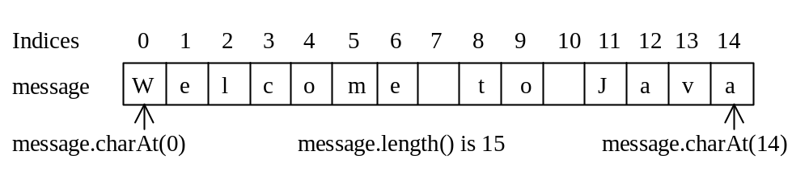
Retrieving Individual Characters in a String
Do not use message[0]
Use message.charAt(index)
Index starts from 0

Slide 9
String Concatenation
String s3 = s1.concat(s2);
String s3 = s1 + s2;

Slide 10
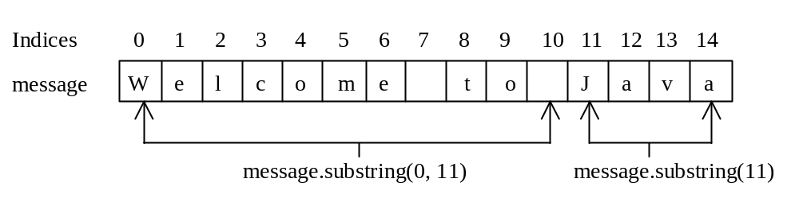
Extracting Substrings
String is an immutable class; its values
cannot be changed individually.
String s1 = "Welcome to Java";
String s2 = s1.substring(0, 11) + "HTML";

Slide 11
String ==
String s = "Welcome to Java!";
String s1 = new String("Welcome to Java!");
String s2 = s1.intern();
System.out.println("s1 == s is " + (s1 == s));
System.out.println("s2 == s is " + (s2 == s));
System.out.println("s1 == s2 is " + (s1 == s2));
displays
s1 == s is false
s2 == s is true
s1 == s2 false
Notes:
Since Strings are objects, the equals(Object) method will return true if two Strings have the same objects. The == operator will only be true if two String references point to the same underlying String object. Hence two Strings representing the same content will be equal when tested by the equals(Object) method, but will only be equal when tested with the == operator if they are actually the same object.

Slide 12
String Comparisons: equals
String s1 = "Welcome";
String s2 = "welcome";
if (s1.equals(s2)){
// s1 and s2 have the same contents
}
if (s1 == s2) {
// s1 and s2 have the same reference
}

Slide 13
compareTo(Object object)
String s1 = "Welcome";
String s2 = "welcome";
if (s1.compareTo(s2) > 0) {
// s1 is greater than s2
}
else if (s1.compareTo(s2) == 0) {
// s1 and s2 have the same reference
}
else
// s1 is less than s2

Slide 14
String Conversions
The contents of a string cannot be changed once the string is created. But you can convert a string to a new string using the following methods:
toLowerCase
toUpperCase
trim
replace(oldChar, newChar)

Slide 15
Finding a Character or a Substring in a String
"Welcome to Java!".indexOf('W')) returns 0.
"Welcome to Java!".indexOf('x')) returns -1.
"Welcome to Java!".indexOf('o', 5)) returns 9.
"Welcome to Java!".indexOf("come")) returns 3.
"Welcome to Java!".indexOf("Java", 5)) returns 11.
"Welcome to Java!".indexOf("java", 5)) returns -1.

Slide 16
Convert Character and Numbers to Strings
valueOf methods for converting a character, an array of characters, and numeric values to strings. These methods have the same name valueOf with different argument types char, char[], double, long, int, and float.
Convert a double value to a string
String.valueOf(5.44).

Slide 17
Finding Palindromes
Checking whether a string is a palindrome: a string that reads the same forward and backward.

Slide 18
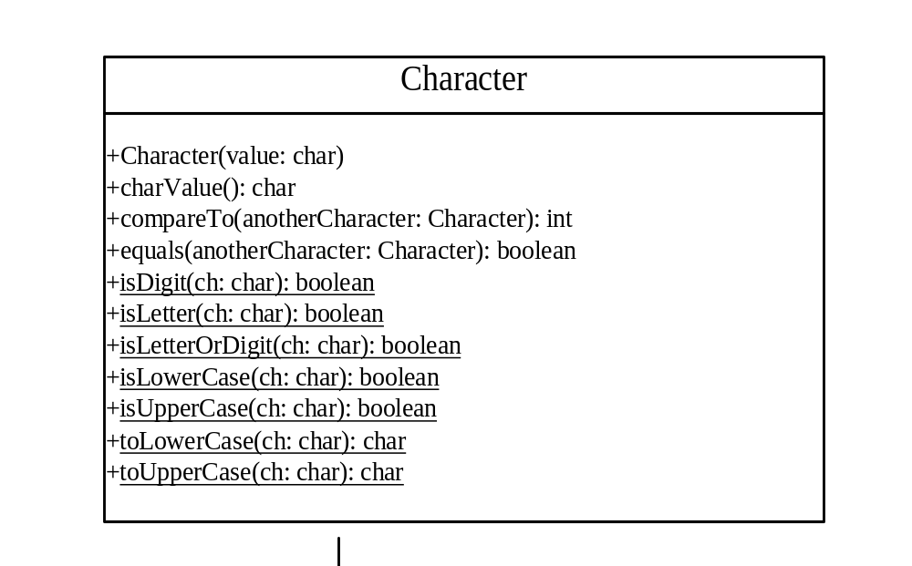
The Character Class

Slide 19
Examples
charObject.compareTo(new Character('a')) returns 1
charObject.compareTo(new Character('b')) returns 0
charObject.compareTo(new Character('c')) returns -1
charObject.compareTo(new Character('d') returns –2
charObject.equals(new Character('b')) returns true
charObject.equals(new Character('d')) returns false

Slide 20
Counting Each Letter in a String
Write a program that counts the number of occurrence of each letter in a string. Assume the letters are not case-sensitive.

Slide 21
The StringBuffer Class
The StringBuffer class is an alternative to the String class. In general, a string buffer can be used wherever a string is used.
StringBuffer is more flexible than String. You can add, insert, or append new contents
into a string buffer. However, the value of
a string is fixed once the string is created.

Slide 22
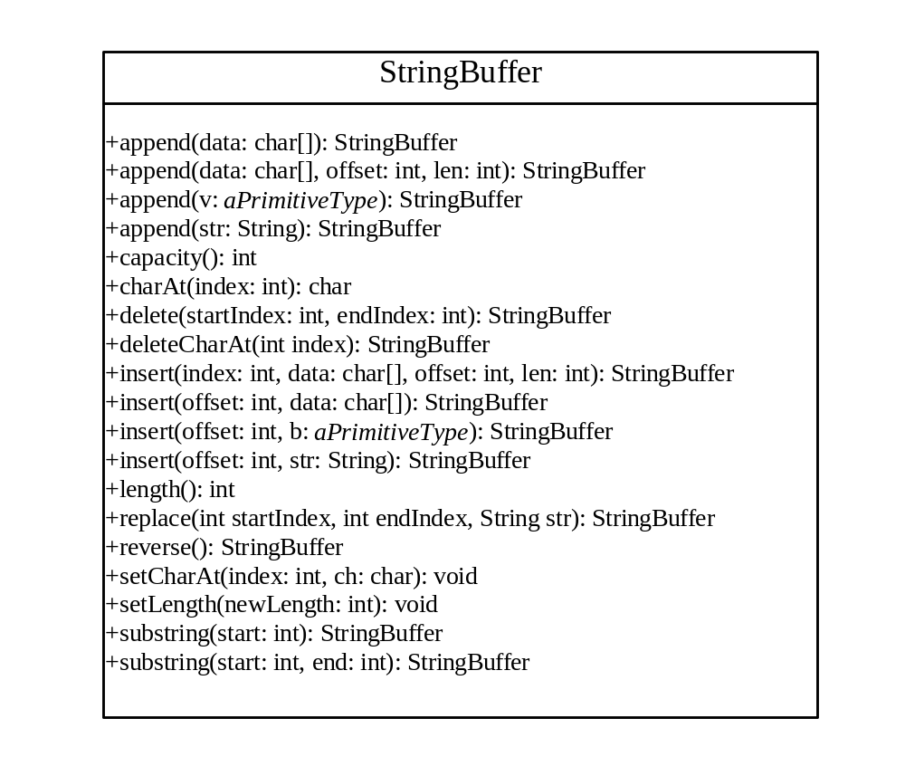

Slide 23
StringBuffer Constructors
public StringBuffer()
No characters, initial capacity 16 characters.
public StringBuffer(int length)
No characters, initial capacity specified by the length argument.
public StringBuffer(String str)
Represents the same sequence of characters
as the string argument. Initial capacity 16
plus the length of the string argument.

Slide 24
Appending New Contents into a String Buffer
StringBuffer strBuf = new StringBuffer();
strBuf.append("Welcome");
strBuf.append(' ');
strBuf.append("to");
strBuf.append(' ');
strBuf.append("Java");

Slide 25
The StringTokenizer Class Constructors
StringTokenizer(String s, String delim, boolean returnTokens)
StringTokenizer(String s, String delim)
StringTokenizer(String s)

Slide 26
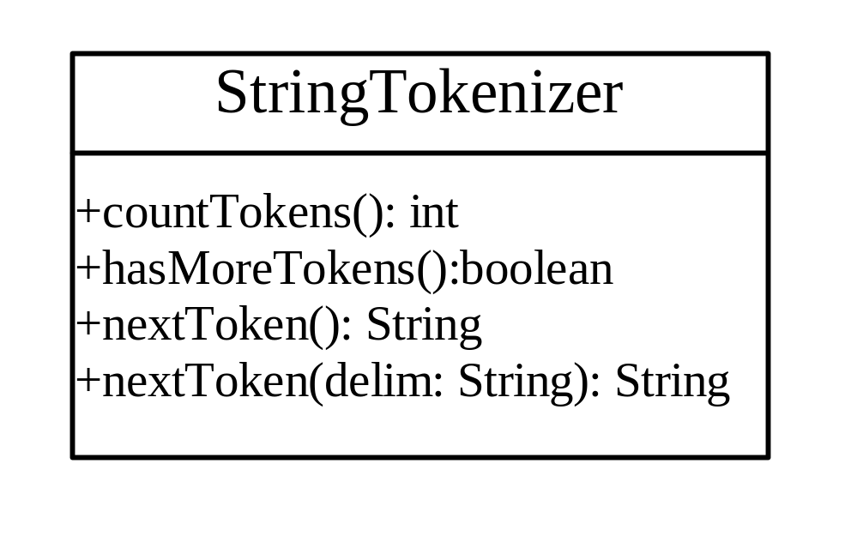
The StringTokenizer Class Methods
boolean hasMoreTokens()
String nextToken()
String nextToken(String delim)

